Slide 1
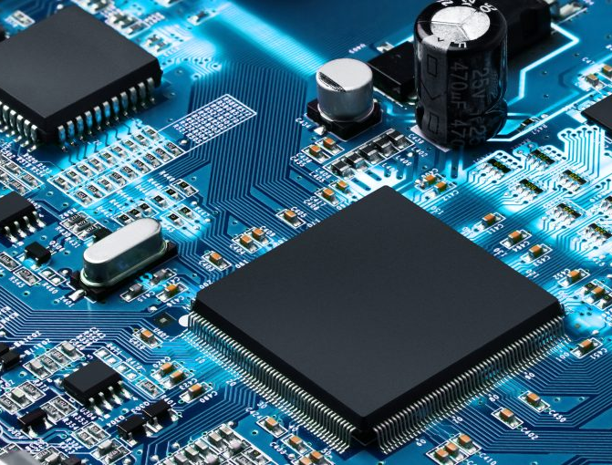



PEMROSESAN PARALEL
CCE60218

Slide 2
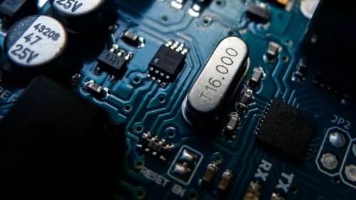
Parallelism & Concurrency

Slide 3
Parallelism & Concurrency
Concurrency
[Threading, Async IO, etc.]
1 processor
Parallelism
[Multiprocessing, etc.]
Many processors

Slide 4
Parallelism & Concurrency
Orange: Running program.
Orange: Running program.
Parallel
Concurrent
Task-3
Task-3
Task-2
Task-2
Task-1
Task-1
t
t
Blue: The complete task (from start to finish).
Blue: The complete task (from start to finish).

Slide 5
Parallelism & Concurrency
NO | Concurrency | Parallelism
1. | Concurrency is the task of running and managing the multiple computations at the same time. | While parallelism is the task of running multiple computations simultaneously.
2. | Concurrency is achieved through the interleaving operation of processes on the central processing unit(CPU) or in other words by the context switching. | While it is achieved by through multiple central processing units(CPUs).
3. | Concurrency can be done by using a single processing unit. | While this can’t be done by using a single processing unit. it needs multiple processing units.
4. | Concurrency increases the amount of work finished at a time. | While it improves the throughput and computational speed of the system.
5. | In concurrency debugging is very hard. | While in this debugging is also hard but simple than concurrency.

Slide 6
Parallelism & Concurrency
Concurrency Type | Switching Decision | # Processors
Pre-emptive multitasking (threading) | The operating system decides when to switch tasks external to Python. | 1
Cooperative multitasking (asyncio) | The tasks decide when to give up control. | 1
Multiprocessing (multiprocessing) | The processes all run at the same time on different processors. | Many

Slide 7
Threading
Process: A process can be thought of as a program in execution.
Thread: A thread is the unit of execution within a process. A process can have anywhere from just one thread to many threads.
Process
Thread 1
Thread 2
Thread 3
time

Slide 8
Asynchronous IO
Async IO: A form of input/output processing that permits other processing to continue before the transmission has finished. Input and output (I/O) operations on a computer can be extremely slow compared to the processing of data.
Process
Thread 1
time

Slide 9
Multiprocessing
Multiprocessing refers to the ability of a system to support more than one processor at the same time. Applications in a multiprocessing system are broken to smaller routines that run independently.
Process
Sub-process 1
Sub-process 2
Sub-process 3
time

Slide 10
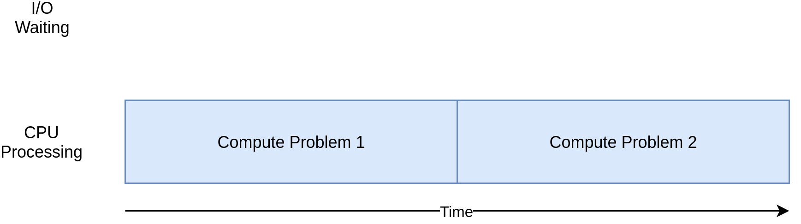
CPU-Bound Process

Slide 11
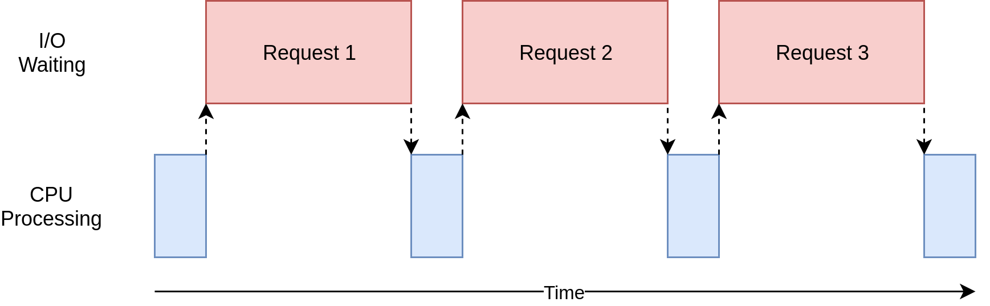
I/O-Bound Process

Slide 12
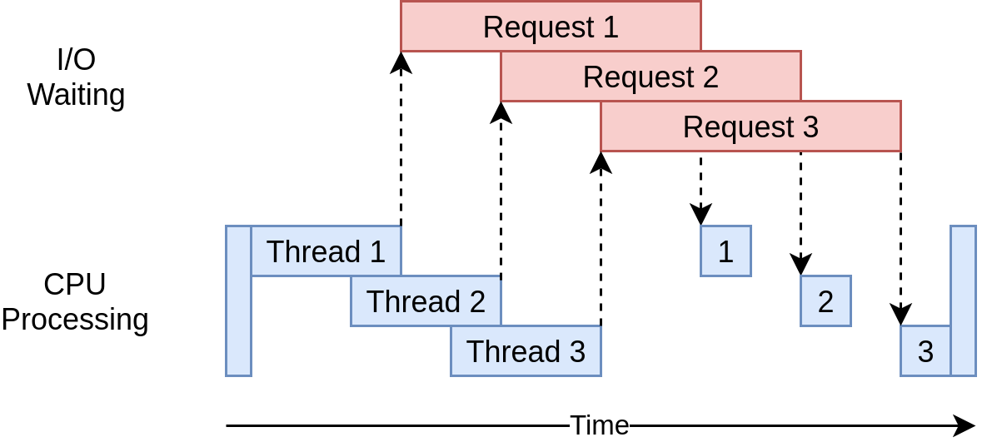
Multithreading

Slide 13
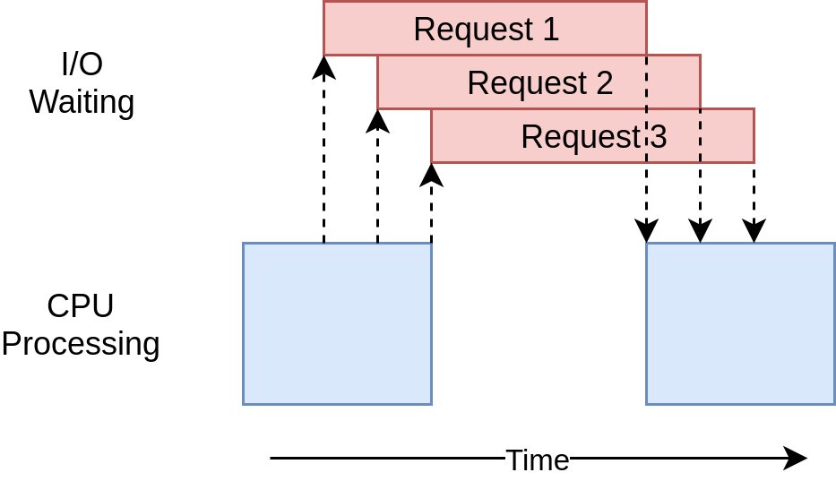
AsyncIO

Slide 14

Terima Kasih

